Slide 1

Selenium Web Automation Testing for Kumon
Pallavi Gupta, Deepali Chougule, Subarna Bera

Slide 2
Content:
Introduction:​
Technology/Tools used:​
Application Overview:​
Purpose and Goal of the Application:
Application key functionalities:
Application Architecture:​
Test Plan:​ Including Test Data and Test Cases
Steps for Executing the Project
​GIT Storage:
CICD with Jenkins:
Test Report:
Grid Integration:

Slide 3
Introduction:
Introduction:
Test automation tools are used to control the execution of tests and then comparing actual outcomes to the predicted outcomes
Selenium is a portable software-testing framework for web applications.
This project focuses on automating Kumon.com website testing on the Firefox and Chrome browser
Test scripts for the test cases were implemented and run on a Windows10 platform using JDK, Selenium IDE and Firebug.
All test cases were executed successfully and the outcomes were identical to the predicted outcomes.

Slide 4
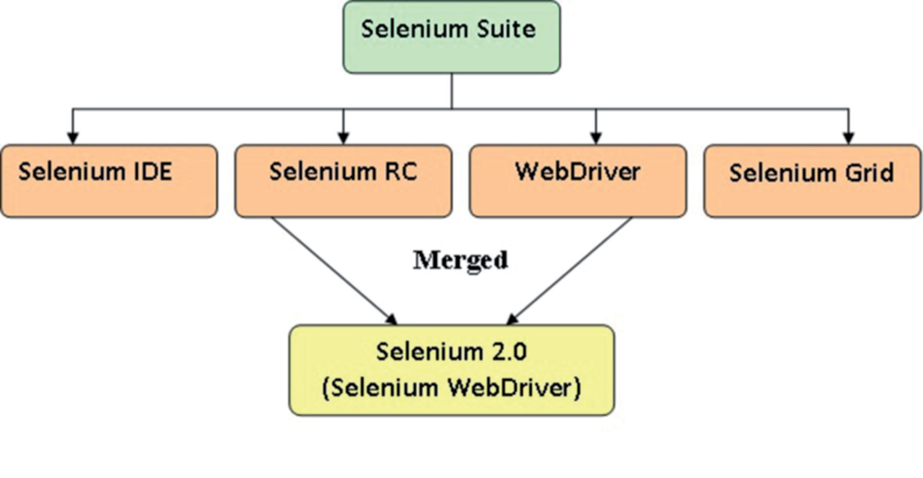
Introduction:
Technology/Tools used:
Java: Programming language to build back-end of web applications and build robust test automation framework
Maven: Using Maven for specifying dependencies, build, and execution. Integrating the TestNG dependency in POM.xml file and running this POM.xml file using Jenkins.
Selenium IDE: It is a Firefox extension that can automate the browser test command through record and playback feature.
Selenium Grid: To run parallel tests across different machines and different browsers all at the same time.
Selenium Web Driver: Used to automate web application testing to verify that it works as expected. It supports many browsers such as Firefox, Chrome, IE, and Safari.

Slide 5
Introduction:
Technology/Tools used:
GIT: Free and open source distributed version control system designed to handle small to very large projects with speed and efficiency. As a part of a team using Git, team members will clone working copy of a local repository from Git server.
Junit: Junit is a unit testing framework for the Java programming language.
Jenkins: Jenkins is an open source tool written in Java. It provides continuous delivery and continuous integration service for software development and deployment.
TestNG: Using TestNG for Assertions, Grouping and Parallel execution. TestNG is a preferred framework of QA analysts as it allows you to generate test reports in both HTML and XML formats and enable you to group test cases easily

Slide 6
Introduction:
Technology/Tools used:
Firebug: It is a Mozilla Firefox add-on. This tool helps in identifying or to be more particular inspecting HTML, CSS and JavaScript elements on a web page.
GeckoDriver: Gecko is a web browser engine used in many applications developed by Mozilla and Geckodriver is the link between the tests in Selenium and the Firefox browser.
Netbeans: qIt is an integrated development environment( IDE) for Java. The dependencies for Selenium server are added in project’s pom file. In this project, we are using NetBeans to run our Selenium scripts
selenium-standalone: It is a jar bundle that contains both API and selenium server. Selenium server is needed to run WebDriver tests in remote machines through Selenium Grid.

Slide 7
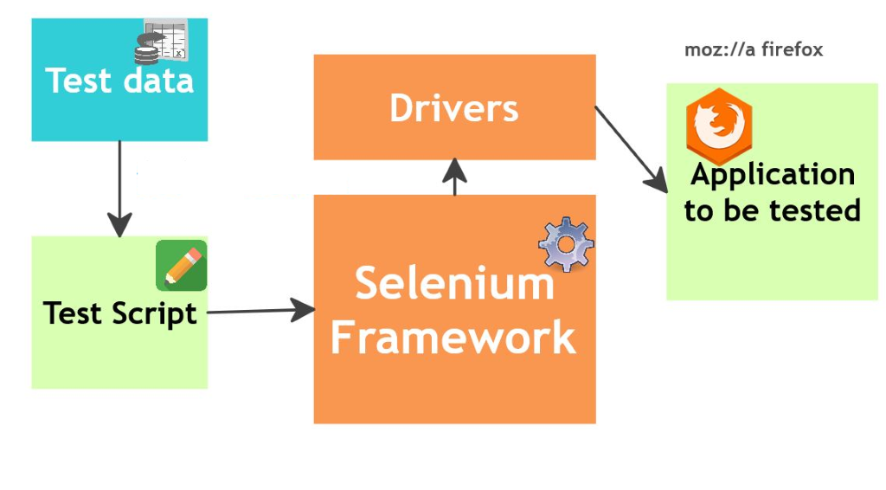
Application Overview:
Avoid repeated manual work
Receive faster feedback
Reduce cost of manual testing
Save time on running tests repeatedly
Ensure that tests are executed consistently with the same preconditions and expectations.

Slide 8
Purpose and Goal of the Application:
Some of the main goal the application in this project are:
Usability testing: The application should comply with accessibility standards.
Example: To ensure proper navigation between web pages.
User acceptance testing: It is to make sure that the application meets the expectations of the user. It ensures that the application is fit enough to be deployed and used effectively.
Example:
To ensure browser compatibility.
To make sure that mandatory fields are given data in forms.
To check for time outs
To be sure that proper control is used to feed data. For example, when requesting gender information, use an option button

Slide 9
Purpose and Goal of the Application
Performance testing​: Performance testing on web applications measures the performance under various scenarios. ​
Example: test automation suite is ensuring simultaneous scalability, maintainability, and reliability. ​
Security testing​: It is very important if data leaks or modifications are unacceptable and intolerable. ​
Example: To ensure that sufficient authentication and authorization mechanisms are in place.​
Functional testing​: It is to ensure that individual functions are working well. ​
Example: ​
Test cases should ensure that boundary conditions are tested. ​
Invalid inputs should prompt appropriate error messages.​
​

Slide 10
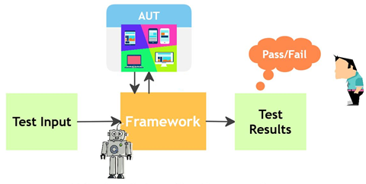
Application key functionalities:
​
To perform repetitive functional and regression testing.
Testing framework which delivered Page object model (POM)approach to maximize reusability.
To test functionality with different sets of data
TestNG framework for test suite execution, and integration with Jenkins.
Parallel execution with the help of Selenium GRID using Hub Node concept
Generating reports which helps to identify the status of the test case (Pass/Fail).
Using reports to calculate time taken by each test case that helps to calculate ROI.
Automation reports can be share with team and clients to report the status of testing progress etc.

Slide 11












Database
Server:
MySQL
Application
Server:
Tomcat
Web
Server:
Apache
Web Application/
Browser
HTML Report
Emailable-Report.html
Configuration files
Start
Selenium WebDriver
Language used: java
Driver used: firefox
GIT Repository
GIT Hub (push Pull)
Continuous Integration
(Jenkins)
Test Data
Automation Test Scripts via Selenium IDE(.java)
Selenium Grid
Test
Build Via Maven
Run Test via TestNG
Surefire
Test Suite
Application Architecture:

Slide 12
Test Plan:
1.Objectives :The purpose of this document is to outline the test strategy and overall test approach for the Kumon project. Kumon is an educational network to teach mathematics and reading for young students. Our Testing will focus on mainly 4 modules:
- Enrolment
- Career search
- Site navigation
- Downloadable and media player
2. Team Members :
Resource Name | Role
Pallavi | Tester
Subarna | Tester
Geetali | Tester

Slide 13
Test Plan:
3. Test Steps:
Create test suite with as many test cases as necessary
have the ability to view it when running the test
Enter results and appropriate comments
View results
4. Test Approach :The project is using an agile approach, with weekly iterations. At the end of each week the requirements identified for that iteration will be delivered to the team and will be tested.
5. Milestones :
Task Name | Start | Finish | Effort | Comments
Test Planning |  |  | 1w
Create and run test suite |  |  | 1w
CICD with Jenkins |  |  | 1w
Collaborating through Github and parallel execution through Grid |  |  | 1w

Slide 14
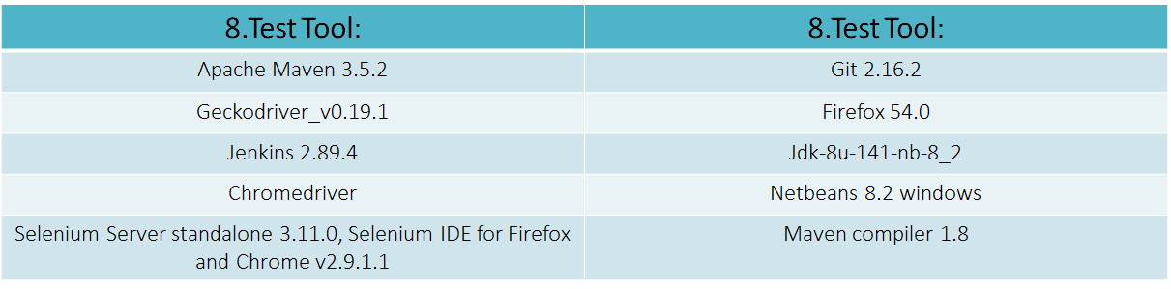
Test Plan:
6. Test Scope : Functional testing, Regression testing, Automation scripting using Selenium with Java, Continuous Integration and automation test execution schedule with Jenkins , sharing and working on Test suite with team members using GIT, Parallel execution under different browser with Grid.
7. Environment: All the modules of the application would be tested in 3 primary browsers for desktops (Windows 64 bit and Mac OS X and higher), namely
- IE (9 and higher)
- Firefox (50 and higher)
- Chrome (31 and higher)

Slide 15
Kumon Test Plan (click)
SR# | Test Scenario/ Test Scope | Test Cases | Test Steps | Test Data | Expected Result | Actual Result | Pass/Fail
1 | Kumon Contact Us form fill up and submission | Verify Contact Us page | 1) Click on "contact us" link |  | 1)User Enter in "contact us" page | 1)User Enter in "contact us" page | Pass
2 |  | Verify to enter to Kumongroup.com page | 1) Click on link "http://kumongroup.com/eng" |  | 1) User redirected to Kumongroup.com page | 1) User redirected to Kumongroup.com page | Pass
3 |  | Verify you can enter data in "Contact Information for Your Inquiries" form | 1) Enter valid data | Title: ms, Name: abc, Email: abc@xyz.com , Country: usa, City: Illinois, phone:2241234567,Question/ Comment: how many kumon franchises are there in illinois? | 1) User can enter the test data | 1) User can enter the test data | Pass
4 |  | Verify submission of Contact us form | 1) Enter Required fields 2) Submit | Title: ms, Name: abc, Email: abc@xyz.com , Country: usa, City: Illinois, phone: 2241234567,Question/ Comment: how many kumon franchises are there in illinois? | 1) User can enter the test data. 2) Success full message will show- " Thank You" | 1) User can enter the test data. 2) Success full message will show- " Thank You" | Pass

Slide 16
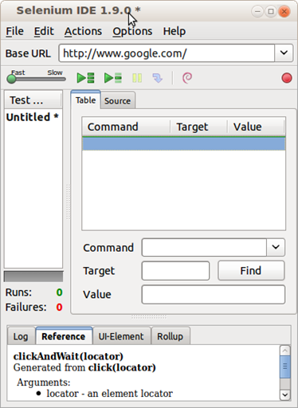
Steps for Executing the Project:
Downloading the necessary files , Download and install the latest Selenium IDE :http://docs.seleniumhq.org/download/
Set JAVA Environment: JDK 1.8
Set TestNG Environment
Install Firefox 54.0
Implementing Selenium to Firefox and NetBeans.
Open Firefox , Start recording in Selenium IDE
Execute scenario on running web application
Stop recording in Selenium IDE
Verify / Add assertions
Replay the test.
Export test case as TestNG.java file

Slide 17
Steps for Executing the Project:
Creating test through Netbeans IDE Webdriver
Create new java maven project in netbeans Selenium_project
Create test package "test" under test package
Configure POM.xml
Created individual TestNG Test cases in separate machines with the help of TestNG.java files exported from IDE:
KumonMathProgram.java
KumonReadingProgram.java
KumonAboutUs.java
KumonContactUs.java
KumonCareers.java
Downloadbrochure.java
<dependencies>
<dependency>
<groupId>org.seleniumhq.selenium</groupId>
<artifactId>selenium-java</artifactId>
<version>3.10.0</version>
</dependency>
<!-- https://mvnrepository.com/artifact/org.testng/testng -->
<dependency>
<groupId>org.testng</groupId>
<artifactId>testng</artifactId>
<version>6.9.10</version>
<scope>test</scope>
</dependency>
<dependency>
<groupId>org.apache.commons</groupId>
<artifactId>commons-lang3</artifactId>
<version>3.3.2</version>
<scope>test</scope>
<type>jar</type>
</dependency>
<dependency>
<groupId>org.seleniumhq.selenium</groupId>
<artifactId>selenium-support</artifactId>
<version>3.10.0</version>
<scope>test</scope>
<type>jar</type>
</dependency>
</dependencies>
<properties>
<project.build.sourceEncoding>UTF-8</project.build.sourceEncoding>
<maven.compiler.source>1.8</maven.compiler.source>
<maven.compiler.target>1.8</maven.compiler.target>
</properties>

Slide 18

Steps for Executing the Project:
Modify the Testcase with the help of Firebug extension in Firefox
Go to a page url
Locate an element
Do something with that element
Verify / Assert the result
Set up test cases under @Test (Marks a class or a method as a part of the test.)
Set up @Before method (The annotated method will be run before each test method.)
Clean build the project and run the test
Locators in Web Driver
A)id
b) name
c) className
d) tagName
e) cssSelector
f) xpath
g) linkText
h) partialLinkText

Slide 19
Steps for Executing the Project:
Example of Selenium Web Driver
// Create a new instance of the Firefox driver
WebDriver driver = new FirefoxDriver();
// (1) Go to a page
driver.get("http://www.kumon.com");
// (2) Locate an element
WebElement element = driver.findElement(By.name("q"));
// (3-1) Enter something to search for
element.sendKeys("abc");
// (3-2) Now submit the form. WebDriver will find the form for us from the element
element.submit();
// (3-3) Wait up to 10 seconds for a condition
WebDriverWait waiting = new WebDriverWait(driver, 10);
waiting.until( ExpectedConditions.presenceOfElementLocated( By.id("pnnext") ) );
// (4) Check the title of the page
if( driver.getTitle().equals("kumon.com - Google Search") )
System.out.println("PASS");
else
System.err.println("FAIL");
//Close the browser
driver.quit();

Slide 20
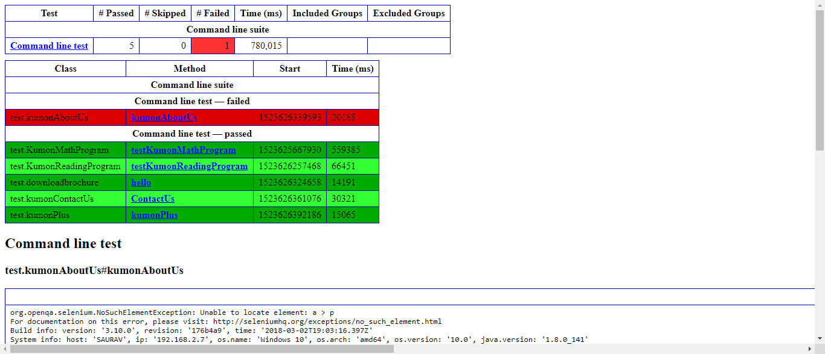
Steps for Executing the Project:
We can see the report from surefire reports e-mailable report
We can save the TestNG report and mail it to others

Slide 21

GIT Storage:
Create individual account in Github , Add collaborators , Create branch
List of Some the Commands which are used for this project:
git init
git clone
git add
git commit
git push
git status
git checkout
git branch
git remote
git pull
Compile test cases in Github
with Netbeans :Repository url
(https://github.com/pKpallavi/Selenium_project.git)
Settings for project configuration to compile and test all files in the project & Connecting NetBeans project to GitHub repository.
(click)

Slide 22

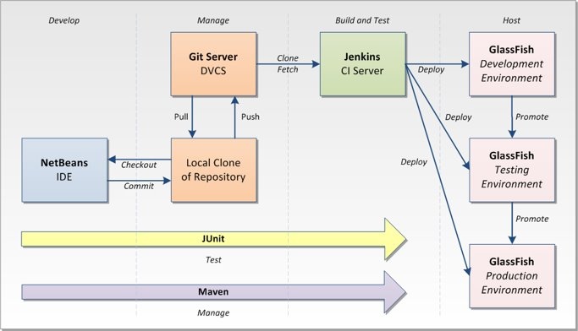
CICD with Jenkins:
Run Jenkins (localhost:8080)
Create new freestyle project "SeleniumProject" In Jenkins
Install plugin for testNG report generation
Configure Jenkins with Github And Maven, Add repository url( https://github.com/pKpallavi/Selenium_project.git.) in source code management
Run build now & Generate TestNG result
Jenkins –Github-maven config (Click)

Slide 23
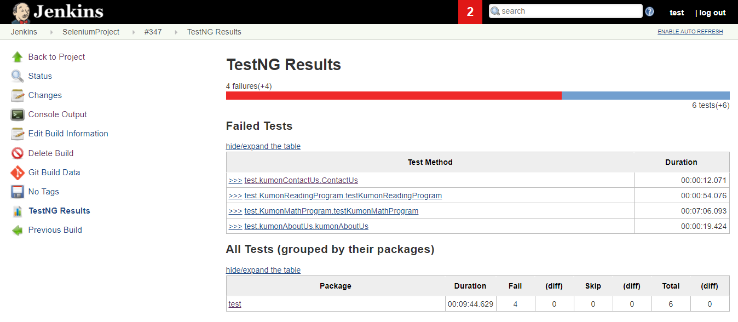
Test Report:

Slide 24

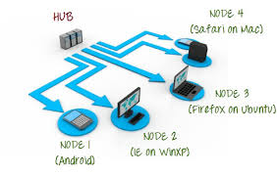
Grid Integration:
Download Selenium Server and Set up Selenium GRID Hub
To verify whether hub is running, open the browser and navigate to http://localhost:4444
Set up Node Machine
Open Command Prompt.
register Hub Machine with Node Machine
After executing the command then return to the Hub and navigate the URL http://localhost:4444 and the hub will now display the node which is attached to it.
Run the test script in Netbeans and the automation will be perform in node machine and we can do the parallel test execution

Slide 25


